Slide 1
STRIVE for the SDGs How can STRIVE’s conceptual approach to understanding and intervening on structural drivers of HIV be used to formulate strategies for achieving the SDGs?

Slide 2
In 2015, the 17 Sustainable Development Goals were adopted by world leaders.
In 2011, STRIVE was established to develop an alternative perspective on fighting the HIV epidemic--replacing short-term thinking and vertical programming on HIV with system thinking on how to address upstream risk factors that HIV shares with multiple development outcomes
What lessons can be brought from STRIVE’s 6 years of research and thought leadership to inform strategies for achieving the SDGs?
Notes:
So we find ourselves at a moment of Convergence!
In 2015, the 17 Sustainable Development Goals were adopted by world leaders. The SDGs signal a new way of thinking about and planning for the future—a future where economic, social and environmental targets are seen as an indivisible and interdependent system.
In 2011, STRIVE was established to develop an alternative perspective on fighting the HIV epidemic--replacing short-term thinking and vertical programming on HIV with system thinking on how to address upstream risk factors that HIV shares with multiple development outcomes
It is our firm belief that we will not be able to realize the promise of the SDGs without applying the type of inter-sectoral, upstream thinking that we been applying to HIV as part of STRIVE.
So today, we’d like to discuss what lessons can be brought from STRIVE’s 7 years of research and thought leadership to inform strategies for achieving the SDGs?

Slide 3
Consider the Case of HIV
Notes:
Let us start by considering the case of HIV – the original focus of the STRIVE portfolio.
Traditionally, HIV programming has been vertically driven and disease specific:
Back in 2015, UNAIDS set as its global target “To eliminate the epidemic by 2030.” using a strategy known as 90-90-90. Largely a treatment as prevention strategy – 90 percent of HIV positive people are tested and know their status; 90 percent of these people are connected with services; and 90 percent of that subset, achieves undetectable viral load.
This strategy has now been called into question – both in its wisdom and its feasibility.
A recent article in the BMJ Global Health conducted a systematic analysis of national HIV treatment cascades, asking: “Can the UNAIDS 90-90-90be achieved?”
A highly influential editorial the next month offered the resounding answer: UNAIDS 90-90-targest to end the AIDS epidemic are NOT realistic….
[Bain, Nkoke, and Noubiap. 2017. BMJ Global Health: 2: e000227.]

Slide 4
Treatment alone won’t be enough
UNAIDS modelling: at best, at 90% and 95% coverage, treatment can avert 60% of new infections (UNAIDS, 2015)
Phylogenetics: Recent HIV infections at least 30 times more infectious than older infections (Fraser C, HIV Phylogenetics: Lessons for HIV Prevention. CROI, 2017)
Effectiveness of Treatment: US HIV patients on treatment are at risk of transmitting virus almost 25% of the time (viral loads > 1500 copies) (Marks G et al, AIDS Care, 2015)
Notes:
The editorial goes on to argue that not only would a disease specific agenda focusing on HIV be unlikely to succeed, it may actually prove counterproductive. The authors observe:
“Meeting the future resource needs for ART scale-up under the 90–90–90 scenario (US$18 billion per year globally) will require significant additional resource mobilisation, which may jeopardise funding of other health programmes.” BMJ Global Health
Besides resources, there are other reasons to question the viability of a largely biomedical approach to combatting HIV.
First, UNAIDS modelling suggests that at best, even with 90 to 95 percent coverage (which is itself unlikely), treatment can avert only 60% of new infections.
Plus the virus is becoming more dangerous: Phylogenetic testing suggests that recent HIV infections are at least 30 times more infectious than older infections – meaning that they spread more easily.
And finally, due to adherence issues, treatment may be less consistently protective than we had hoped. For example, US HIV patients on treatment are at risk of transmitting the virus almost 25% of the time.

Slide 5
UNAIDS targets for 2020 compared with
global estimates for 2014/15.
90%
81%
73%
Jacob Levi et al. BMJ Global Health 2016;1:e000010
Notes:
This slide compares the UNAIDS targets for 2020 for universal treatment with global estimates for what had been achieved by 2014/15.
According to UNAIDS, 36.9 million people were HIV positive in 2015.
In a recent systematic analysis of national HIV treatment cascades from 69 countries by Levi et al² in BMJ Global Health, none of the countries had met the 90–90–90 targets.
Globally, only 54% of people living with HIV know their status
They found that diagnosis (target one—90% of all HIV-positive people diagnosed) ranged from 87% (the Netherlands) to 11% (Yemen). This means on average, only 54% of HIV positive people know their status, rather than the 90% set in the goal)
SEE ORGANGE BAR
Target two is that 90 percent of those who know their status (or 81% of all HIV positive people), should be on treatment. Treatment coverage ranged from 71% in Switzerland (which is fairly close) to an abysmal 3% in Afghanistan.
The yellow bar shows that less than half of those on ART are actually virally suppressed (or less than 1/3 of people who are HIV positive in these 69 countries.
For those interested in the US example, only 52% of HIV-positive people are on treatment, with 82% of these having full viral suppression. This illustrates the difficulty of maintaining not only early diagnosis but the sustained medical and social efforts required to achieve optimal therapeutic and prevention results.

Slide 6
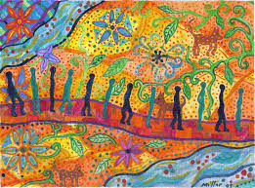
2030 Agenda and the SDGs
UNIVERSALITY
INTEGRATION
‘NO ONE LEFT BEHIND’
Implies that goals and targets are relevant to all governments and actors.
Universality does not mean uniformity. It implies differentiation (What can each country contribute?)
Policy integration means balancing all three SD dimensions: social, economic growth and environmental protection
An integrated approach implies managing trade-offs and maximizing synergies across targets
The principle of ‘no one left behind’ advocates countries to go beyond averages.
The SDGs should benefit all – eradicating poverty and reducing inequalities.
Promotion and use of disaggregated data is key
Notes:
The 2030 Agenda for Sustainable Development is based on the principles of universality, integration, and “leaving no one behind”. Significantly, and in contrast to the Millennium Development Goals, the 2030 Agenda and the SDGs apply to all countries, not just low and middle income countries
The SDGs are in fact not a list of separate goals, but rather, a system – a network of highly connected goals across the three dimensions of sustainable development: Economic, Environment and Social
Finally ,reaching the furthest behind first is particularly important under this new development agenda to tackle inequality and ensure all people benefit from SDG implementation. This means that we can no longer monitor our progress simply in terms of population averages – we must ensure that individuals confronting multiple interlocking disadvantages also benefit.

Slide 7
Achieving the SDGs is an ambitious expensive undertaking…
And money does not grow on trees
So we have to be smart
Notes:
Not surprisingly, achieving the SDGs is an ambitious and hugely expensive undertaking…
And money does not grow on trees
So we have to be smart
What does that look like?

Slide 8
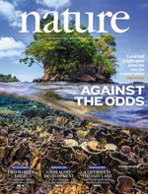
Influential article in Nature encourages policy makers to analyze the SDG targets and goals for “sweet spots” – opportunities to invest that in one area that yield multiple benefits without undermining other goals
Notes:
Influential article in Nature encourages policy makers to analyze the SDG targets and goals for “sweet spots” – opportunities to invest that in one area that yield multiple benefits without undermining other goals
It emphasizes the reality that the SDGs are a system – an ecology, and we must examine how different goals and targets with support, or potentially undermine each other.
As you see on the right, the Nature authors offer a first attempt at a “scoring” scheme for identifying best investments across sectors.
It encourages planners to consider investments in light of how they would interact with other goals and targets--from reinforcing and enabling to counteracting or even cancelling any positive benefit that could come from investment in another area. For example investing in strip mining might help meet an energy goal, but it would undermine various other water, environmental and climate change goals.

Slide 9
STRIVE’s Contributions
STRIVE research has identified a set of key social and structural drivers that offer investment opportunities to realize co-benefits, multiply impacts and achieve development synergies.
Notes:
So how does this relate to STRIVE?
STRIVE research has identified a set of key social and structural drivers that offer investment opportunities to realize co-benefits, multiply impacts and achieve development synergies

Slide 10
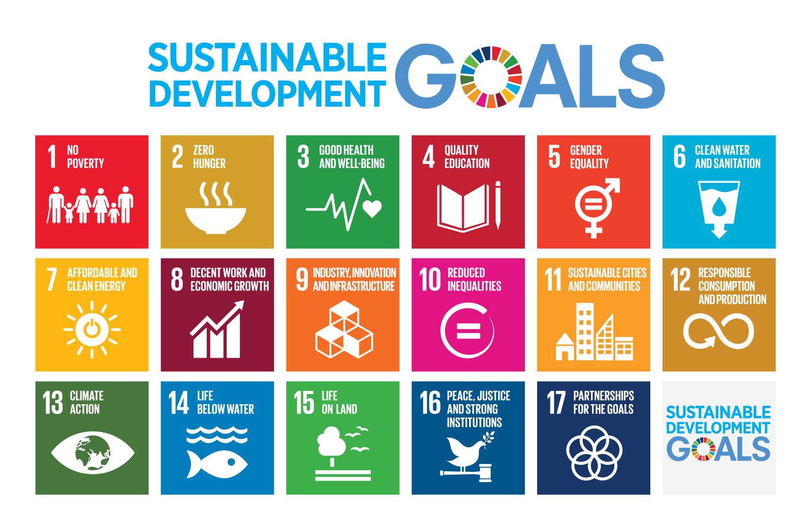
So what are these multipliers?
Notes:
So what are these multipliers?
Well there are many, but today we are going to explore 3 in more depth.
Specifically
Addressing harmful alcohol use,
Keeping girls in school, and
Expanding social protection ( or cash transfer) programmes for families.
We are using these as examples to make our larger point about the need to focus investment upstream on items that hold the potential to yield multiple development synergies.

Slide 11
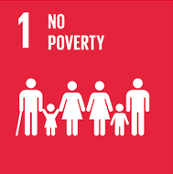
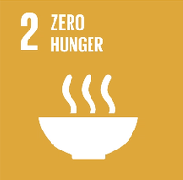
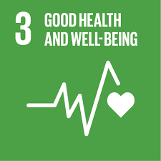
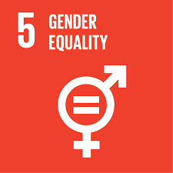
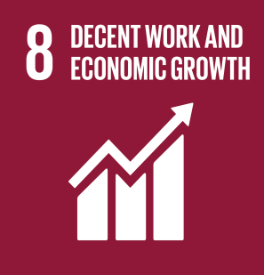
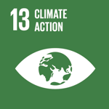
Eliminate gender disparities in education (Goal 4, Target 5)
HIV RISK BEHAVIOURS AND SUSCEPTIBILITY TO INFECTION
(early sexual debut, number of partners, risk of partners, transactional sex, condom non-use)
Notes:
An extra year of secondary schooling for girls can increase their future wages by 10 to 20 percent.
Women with secondary education have, on average, 1.5 fewer children than those with primary schooling.
Secondary education reduces the vulnerability of girls to human trafficking, child marriage and other forms of abuse. In fact, if all girls had secondary education in sub-Saharan Africa and South and West Asia, child marriage would fall by 64%, from almost 2.9 million to just over 1 million.
Women with post-primary education are five times more likely than illiterate women to be educated on the topic on the topic of HIV and AIDS, and are thereby equipped with the knowledge to practice safer sex and prevent infection
Women with more education report having more decision power over their own earnings whether it is alone or with someone else.
Source: The World Bank, 2012.
Women’s education alone resulted in a 43 percent reduction in hunger from 1970 to 1995, while women living longer led to an additional 12 percent decline in hunger levels, according to the report by the U.N. Food and Agriculture Organisation (FAO) and the Asian Development Bank (ADB).

Slide 12
Each additional year of secondary school is associated with a 43% reduction in HIV prevalence among women 1990-2013
Eliminate gender disparities in education (Goal 4, Target 5)
= Indivisible
= Reinforcing
= Enabling
Notes:
An extra year of secondary schooling for girls can increase their future wages by 10 to 20 percent.
Women with secondary education have, on average, 1.5 fewer children than those with primary schooling.
Secondary education reduces the vulnerability of girls to human trafficking, child marriage and other forms of abuse. In fact, if all girls had secondary education in sub-Saharan Africa and South and West Asia, child marriage would fall by 64%, from almost 2.9 million to just over 1 million.
Women with post-primary education are five times more likely than illiterate women to be educated on the topic on the topic of HIV and AIDS, and are thereby equipped with the knowledge to practice safer sex and prevent infection
Women with more education report having more decision power over their own earnings whether it is alone or with someone else.
Source: The World Bank, 2012.
Women’s education alone resulted in a 43 percent reduction in hunger from 1970 to 1995, while women living longer led to an additional 12 percent decline in hunger levels, according to the report by the U.N. Food and Agriculture Organisation (FAO) and the Asian Development Bank (ADB).

Slide 13
Each additional year of secondary school is associated with a 43% reduction in HIV prevalence among women 1990-2013
Girls education would reduce child marriage by 64% in SSA and West Asia
Eliminate gender disparities in education (Goal 4, Target 5)
= Indivisible
= Reinforcing
= Enabling
Notes:
An extra year of secondary schooling for girls can increase their future wages by 10 to 20 percent.
Women with secondary education have, on average, 1.5 fewer children than those with primary schooling.
Secondary education reduces the vulnerability of girls to human trafficking, child marriage and other forms of abuse. In fact, if all girls had secondary education in sub-Saharan Africa and South and West Asia, child marriage would fall by 64%, from almost 2.9 million to just over 1 million.
Women with post-primary education are five times more likely than illiterate women to be educated on the topic on the topic of HIV and AIDS, and are thereby equipped with the knowledge to practice safer sex and prevent infection
Women with more education report having more decision power over their own earnings whether it is alone or with someone else.
Source: The World Bank, 2012.
Women’s education alone resulted in a 43 percent reduction in hunger from 1970 to 1995, while women living longer led to an additional 12 percent decline in hunger levels, according to the report by the U.N. Food and Agriculture Organisation (FAO) and the Asian Development Bank (ADB).

Slide 14
Each additional year of secondary school is associated with a 43% reduction in HIV prevalence among women 1990-2013
Girls education would reduce child marriage by 64% in SSA and West Asia
Eliminate gender disparities in education (Goal 4, Target 5)
An extra year of secondary school for girls increases her future wages by 10-20%
= Indivisible
= Reinforcing
= Enabling
Notes:
An extra year of secondary schooling for girls can increase their future wages by 10 to 20 percent.
Women with secondary education have, on average, 1.5 fewer children than those with primary schooling.
Secondary education reduces the vulnerability of girls to human trafficking, child marriage and other forms of abuse. In fact, if all girls had secondary education in sub-Saharan Africa and South and West Asia, child marriage would fall by 64%, from almost 2.9 million to just over 1 million.
Women with post-primary education are five times more likely than illiterate women to be educated on the topic on the topic of HIV and AIDS, and are thereby equipped with the knowledge to practice safer sex and prevent infection
Women with more education report having more decision power over their own earnings whether it is alone or with someone else.
Source: The World Bank, 2012.
Women’s education alone resulted in a 43 percent reduction in hunger from 1970 to 1995, while women living longer led to an additional 12 percent decline in hunger levels, according to the report by the U.N. Food and Agriculture Organisation (FAO) and the Asian Development Bank (ADB).

Slide 15
Each additional year of secondary school is associated with a 43% reduction in HIV prevalence among women 1990-2013
Girls education would reduce child marriage by 64% in SSA and West Asia
Eliminate gender disparities in education (Goal 4, Target 5)
An extra year of secondary school for girls increases her future wages by 10-20%
Women’s education alone resulted in a 43% reduction in hunger from 1970 to 1995
= Indivisible
= Reinforcing
= Enabling
Notes:
An extra year of secondary schooling for girls can increase their future wages by 10 to 20 percent.
Women with secondary education have, on average, 1.5 fewer children than those with primary schooling.
Secondary education reduces the vulnerability of girls to human trafficking, child marriage and other forms of abuse. In fact, if all girls had secondary education in sub-Saharan Africa and South and West Asia, child marriage would fall by 64%, from almost 2.9 million to just over 1 million.
Women with post-primary education are five times more likely than illiterate women to be educated on the topic on the topic of HIV and AIDS, and are thereby equipped with the knowledge to practice safer sex and prevent infection
Women with more education report having more decision power over their own earnings whether it is alone or with someone else.
Source: The World Bank, 2012.
Women’s education alone resulted in a 43 percent reduction in hunger from 1970 to 1995, while women living longer led to an additional 12 percent decline in hunger levels, according to the report by the U.N. Food and Agriculture Organisation (FAO) and the Asian Development Bank (ADB).

Slide 16
Each additional year of secondary school is associated with a 43% reduction in HIV prevalence among women 1990-2013
Girls education would reduce child marriage by 64% in SSA and West Asia
Eliminate gender disparities in education (Goal 4, Target 5)
An extra year of secondary school for girls increases her future wages by 10-20%
Women’s education alone resulted in a 43% reduction in hunger from 1970 to 1995
Each additional year of education for girls results in 9 fewer births per 1000 women.
= Indivisible
= Reinforcing
= Enabling
Notes:
An extra year of secondary schooling for girls can increase their future wages by 10 to 20 percent.
Women with secondary education have, on average, 1.5 fewer children than those with primary schooling.
Secondary education reduces the vulnerability of girls to human trafficking, child marriage and other forms of abuse. In fact, if all girls had secondary education in sub-Saharan Africa and South and West Asia, child marriage would fall by 64%, from almost 2.9 million to just over 1 million.
Women with post-primary education are five times more likely than illiterate women to be educated on the topic on the topic of HIV and AIDS, and are thereby equipped with the knowledge to practice safer sex and prevent infection
Women with more education report having more decision power over their own earnings whether it is alone or with someone else.
Source: The World Bank, 2012.
Women’s education alone resulted in a 43 percent reduction in hunger from 1970 to 1995, while women living longer led to an additional 12 percent decline in hunger levels, according to the report by the U.N. Food and Agriculture Organisation (FAO) and the Asian Development Bank (ADB).

Slide 17
Each additional year of secondary school is associated with a 43% reduction in HIV prevalence among women 1990-2013
Girls education would reduce child marriage by 64% in SSA and West Asia
Eliminate gender disparities in education (Goal 4, Target 5)
An extra year of secondary school for girls increases her future wages by 10-20%
Women’s education alone resulted in a 43% reduction in hunger from 1970 to 1995
Each additional year of education for girls results in 9 fewer births per 1000 women.
Girls’ educational attainment associated with national index score of vulnerability to climate disasters.
= Indivisible
= Reinforcing
= Enabling
Notes:
An extra year of secondary schooling for girls can increase their future wages by 10 to 20 percent.
Women with secondary education have, on average, 1.5 fewer children than those with primary schooling.
Secondary education reduces the vulnerability of girls to human trafficking, child marriage and other forms of abuse. In fact, if all girls had secondary education in sub-Saharan Africa and South and West Asia, child marriage would fall by 64%, from almost 2.9 million to just over 1 million.
Women with post-primary education are five times more likely than illiterate women to be educated on the topic on the topic of HIV and AIDS, and are thereby equipped with the knowledge to practice safer sex and prevent infection
Women with more education report having more decision power over their own earnings whether it is alone or with someone else.
Source: The World Bank, 2012.
Women’s education alone resulted in a 43 percent reduction in hunger from 1970 to 1995, while women living longer led to an additional 12 percent decline in hunger levels, according to the report by the U.N. Food and Agriculture Organisation (FAO) and the Asian Development Bank (ADB).

Slide 18
Ending Violence against Women
Goal 5, Target 2
HIV RISK BEHAVIOURS AND SUSCEPTIBILITY TO INFECTION
(early sexual debut, number of partners, risk of partners, transactional sex, condom non-use)
Notes:
Cash transfers have increasingly been adopted in low and middle-income countries as a key strategy for poverty reduction and social protection. They have also been shown in some cases to have an impact on HIV acquisition and forward transmission.
Some 130 countries no have at least one UCT, including 40 out of 48 countries in sub-Saharan Africa (ODI 2016)
Let’s look at the direct evidence on HIV-related behaviors.
A set of studies, including an RCT in Malawi, a cluster randomized Trial in Kenya and 2 propensity matched studies of South African’s national social protection programme, demonstrate that cash transfers can reduce HIV-related risk behavior among adolescents, especially girls.
A recent review of the evidence of the impact of cash transfers on a broad range of indicators suggests that CTs can improve a host of additional upstream structural risk factors (Bastagli et al, 2016, ODI).

Slide 19
Ending Violence against Women
Goal 5, Target 2
Women exposed to intimate partner violence are on average twice as likely to experience depression, 16% more likely to have a low birth weight baby and roughly 1.5 times more likely to acquire HIV, syphilis, chlamydia or gonorrhoea (WHO 2013).
= Indivisible
= Reinforcing
= Enabling
Notes:
Cash transfers have increasingly been adopted in low and middle-income countries as a key strategy for poverty reduction and social protection. They have also been shown in some cases to have an impact on HIV acquisition and forward transmission.
Some 130 countries no have at least one UCT, including 40 out of 48 countries in sub-Saharan Africa (ODI 2016)
Let’s look at the direct evidence on HIV-related behaviors.
A set of studies, including an RCT in Malawi, a cluster randomized Trial in Kenya and 2 propensity matched studies of South African’s national social protection programme, demonstrate that cash transfers can reduce HIV-related risk behavior among adolescents, especially girls.
A recent review of the evidence of the impact of cash transfers on a broad range of indicators suggests that CTs can improve a host of additional upstream structural risk factors (Bastagli et al, 2016, ODI).

Slide 20
Lifetime experience of IPV associated with child stunting. In Bangladesh, women were more likely to have a stunted child if they had lifetime experience of physical IPV [(OR)adj, 1.48]
Ending Violence against Women
Goal 5, Target 2
Women exposed to intimate partner violence are on average twice as likely to experience depression, 16% more likely to have a low birth weight baby and roughly 1.5 times more likely to acquire HIV, syphilis, chlamydia or gonorrhoea (WHO 2013).
= Indivisible
= Reinforcing
= Enabling
Notes:
Cash transfers have increasingly been adopted in low and middle-income countries as a key strategy for poverty reduction and social protection. They have also been shown in some cases to have an impact on HIV acquisition and forward transmission.
Some 130 countries no have at least one UCT, including 40 out of 48 countries in sub-Saharan Africa (ODI 2016)
Let’s look at the direct evidence on HIV-related behaviors.
A set of studies, including an RCT in Malawi, a cluster randomized Trial in Kenya and 2 propensity matched studies of South African’s national social protection programme, demonstrate that cash transfers can reduce HIV-related risk behavior among adolescents, especially girls.
A recent review of the evidence of the impact of cash transfers on a broad range of indicators suggests that CTs can improve a host of additional upstream structural risk factors (Bastagli et al, 2016, ODI).

Slide 21
Lifetime experience of IPV associated with child stunting. In Bangladesh, women were more likely to have a stunted child if they had lifetime experience of physical IPV [(OR)adj, 1.48]
Ending Violence against Women
Goal 5, Target 2
Women who are exposed to intimate partner violence are employed in higher numbers in casual and part-time work, and their earnings are 60 per cent lower, compared to women who do not experience such violence.
Women exposed to intimate partner violence are on average twice as likely to experience depression, 16% more likely to have a low birth weight baby and roughly 1.5 times more likely to acquire HIV, syphilis, chlamydia or gonorrhoea (WHO 2013).
= Indivisible
= Reinforcing
= Enabling
Notes:
Cash transfers have increasingly been adopted in low and middle-income countries as a key strategy for poverty reduction and social protection. They have also been shown in some cases to have an impact on HIV acquisition and forward transmission.
Some 130 countries no have at least one UCT, including 40 out of 48 countries in sub-Saharan Africa (ODI 2016)
Let’s look at the direct evidence on HIV-related behaviors.
A set of studies, including an RCT in Malawi, a cluster randomized Trial in Kenya and 2 propensity matched studies of South African’s national social protection programme, demonstrate that cash transfers can reduce HIV-related risk behavior among adolescents, especially girls.
A recent review of the evidence of the impact of cash transfers on a broad range of indicators suggests that CTs can improve a host of additional upstream structural risk factors (Bastagli et al, 2016, ODI).

Slide 22
Lifetime experience of IPV associated with child stunting. In Bangladesh, women were more likely to have a stunted child if they had lifetime experience of physical IPV [(OR)adj, 1.48]
The cost of violence against women could amount to around 2 per cent of the global gross domestic product (GDP). Estimate of 1.5 trillion per year.
Ending Violence against Women
Goal 5, Target 2
Women who are exposed to intimate partner violence are employed in higher numbers in casual and part-time work, and their earnings are 60 per cent lower, compared to women who do not experience such violence.
Women exposed to intimate partner violence are on average twice as likely to experience depression, 16% more likely to have a low birth weight baby and roughly 1.5 times more likely to acquire HIV, syphilis, chlamydia or gonorrhoea (WHO 2013).
= Indivisible
= Reinforcing
= Enabling
Notes:
Cash transfers have increasingly been adopted in low and middle-income countries as a key strategy for poverty reduction and social protection. They have also been shown in some cases to have an impact on HIV acquisition and forward transmission.
Some 130 countries no have at least one UCT, including 40 out of 48 countries in sub-Saharan Africa (ODI 2016)
Let’s look at the direct evidence on HIV-related behaviors.
A set of studies, including an RCT in Malawi, a cluster randomized Trial in Kenya and 2 propensity matched studies of South African’s national social protection programme, demonstrate that cash transfers can reduce HIV-related risk behavior among adolescents, especially girls.
A recent review of the evidence of the impact of cash transfers on a broad range of indicators suggests that CTs can improve a host of additional upstream structural risk factors (Bastagli et al, 2016, ODI).

Slide 23
How to Act
Acting on multiplier investment opportunities will require innovative forms of governance*, program planning and resourcing across sectors, constituencies, and stakeholders.
Notes:
High return investments

Slide 24
Challenges when taking a multi-sectoral perspective
Single sectoral payers seek to maximise one or two outcomes
For example, health payers seek to improve health by implementing programmes delivered by the health care system
Risks missing two critical issues:
Multiple ‘sectors’ contribute to health gain, especially in terms of addressing the structural determinants of health
BUT they are not primarily aiming to maximise health
Goods and services produced by the ‘health sector’ also have multiple benefits besides health
Current approaches to calculating cost effectiveness don’t acknowledge these cross-issue benefits, and thus under-value investment in upstream social determinants.

Slide 25
Cash transfers and HIV
Source: Baird et al, Lancet, 2012
Notes:
Evidence of impact of cash transfers on HIV...
This study from Malawi (Baird et al 2012) is an important one, which found a reduction in HIV and HSV-2 risk, as well as reduced school drop-out, early marriage and teen pregnancies.
There is more evidence on the impact of cash on HIV, but other studies have focused on intervention models that use cash as a direct conditional incentive to modify more proximal HIV-related behaviour, rather than as a means to address more upstream structural determinants of risk.
Worth noting that the effect found was on prevalent HIV and not incident HIV.

Slide 26
Challenges in implementing new co-financing models
STRIVE is working with UNDP and national governments to operationalize these approaches in development practice.
Expanded Tanzania Social Action Fund (TASAF)
Coordinated HIV prevention interventions, including cash transfer programmes for young women aged 15-24
Integrated school-based, gender-sensitive WASH programme
Notes:
STRIVE economists have now developed a methodology that allows policy makers to do cost effectiveness assessments of programmes that have multiple downstream benefits.
They have developed a way to determine what proportion of a cost of an intervention should appropriately be covered by a particular sector—say education, or reproductive health -- given the benefits that would accrue to that sector or population. This is the work that we have done in our “co-financing” working group.
The biggest barrier to implementing this type of co-financing, is that Ministries are organized vertically by sector, and there are few mechanisms to facilitate cross-sectoral planning.
During this final phase of STRIVE, our co-financing working group is working with UNDP and local partners to implement 3 country-level demonstration projects. The goal is to develop local planning processes to try to operationalize a co-financing solution.
’m not going to go into the models in a lot of depth, but I’ve listed them here to give you a sense of what these governments focused on. As you can see, there was a heavy emphasis on the scale up of social protection programmes, with expected outcomes spanning HIV prevention, uptake of community health insurance, improved maternal and child health and reduced water-borne illnesses – not to mention the broader positive benefits on structural drivers.
Notes:
Tanzania. Tanzania’s co-financing model focuses on the efficient financing of the Tanzania Social Action Fund (TASAF). This is the national cash transfer programme, currently run as a project with a World Bank loan. A 2014 WB evaluation found a range of impacts on health, education, agricultural assets and household savings. Health impacts expected from Tanzania’s model include: accessible and affordable health care services; reduced HIV infections and AIDS-related deaths; reduced sick days from work; and increased uptake of community health insurance.
South Africa. South Africa’s co-financing model focuses on a programme to create youth groups for adolescent girls, offering a range of services conditional on attendance. The model features cash transfers to adolescent girls aged 15-24. Health impacts expected from South Africa’s model include: increased access to health services; improved maternal health; improved sexual and reproductive health; and HIV prevention.
Ethiopia. Ethiopia’s co-financing model involves building separate sanitary facilities in schools, a programme currently funded by a single donor with the potential to be scaled up nationally with benefits for education, water and sanitation, health, gender equality and, therefore, long-term economic growth. Health impacts expected from Ethiopia’s co-financing model include: expanded delivery of health information/services; improved maternal health; reduced water-borne illness; and improved sexual and reproductive health.
Malawi. Malawi’s co-financing model focuses on the national Social Cash Transfer Scheme (SCTS). Health impacts expected from Malawi’s model include, based on evaluations of the SCTS to date: increased use of curative health services (demand creation); delayed sexual debut; reduced teen pregnancy; HIV prevention; reduced incidence of early marriage; and better nutrition amongst the poorest.

Slide 27
Final Thoughts
As with STRIVE, the ultimate challenge for the SDGs will be to encourage co-financing of select “best buys” that deliver multiple benefits across different goals.
HIV taught us that the challenge is both technical (what are those multiplier investments?) and political (how to get governments and ministries to co-invest)
The answer requires not just innovative financing, but political will and activist demands
This too, HIV taught us….
The SDGs will only be met if there is an active movement for accountability

Slide 28
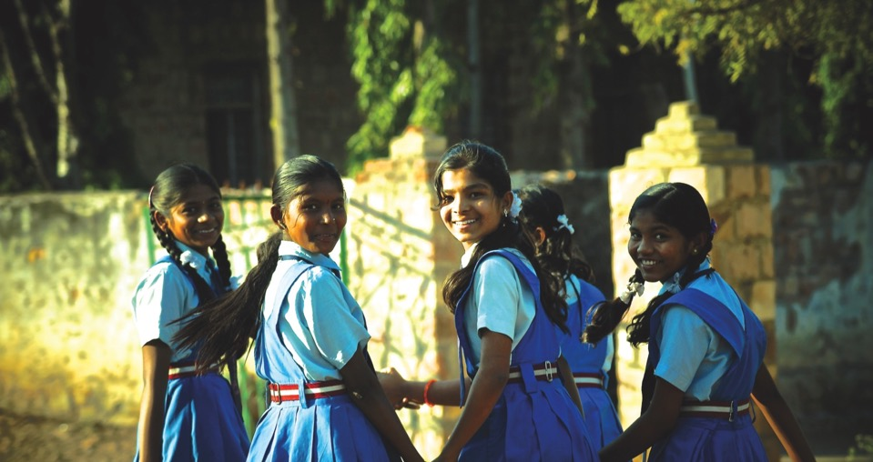
The Samata intervention to increase secondary school completion and reduce child marriage among adolescent girls from marginalised communities in northern Karnataka, south India

Slide 29
Introduction
Trial
Samata: Keeping girls in secondary school and delaying marriage
Geography
Two rural districts (Bagalkote and Vijayapura) of northern Karnataka, south India
Population
Adolescent girls aged 13-14 from marginalised communities
Improve the quality of life of adolescent girls by supporting entry into and retention in secondary school, thereby delaying marriage and entry into sex work
Aims to
To enhance educational attainment (SDG4.1), eliminate harmful practices like child marriage (SDG5.3), and reduce the longer-term risk of HIV-infection (SDG 3.3) by keeping young girls in school
Synergy potential

Slide 30
Intervention and Evaluation
A cluster RCT between 2014-17 which evaluated the intervention among girls aged 15-16 at endline, their families, and school

Slide 31
Results: No difference in primary and secondary outcomes by trial arm

Slide 32
In one of the two districts – Vijayapura – increased secondary school entry and completion rates were associated with Samata
**
**
** p<0.05
** p<0.05

Slide 33
Key learnings
To address secondary school dropout and child marriage among girls, a multi-level intervention is needed and is feasible to implement even in the most marginalised communities who are generally ‘left-behind’
We observed large secular changes in secondary school completion and marriage rates potentially due to successful implementation of government schemes over the past two decades, making it difficult to assess the value of the Samata intervention
Though similar structural forces affect schooling and marriage, the intervention in Vijayapura could improve only school enrolment and completion not marriage - perhaps due to stronger cultural forces linked to marriage
Identifying the context-specific underlying norms that impact schooling and marriage outcomes are crucial
Despite these improvements, still a substantial proportion of girls from the marginalised communities remain at-risk, calling for the design of more focused and targeted interventions
Notes:
Also find out what was secondary school completion and child marriage rates in 50s to compare against 75% and 10% (unable to understand the comment)

Slide 34
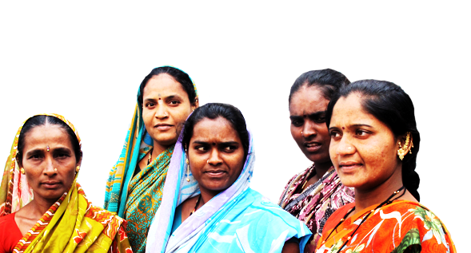
Samvedana Plus: Reducing violence and increasing condom use in the intimate partnerships of female sex workers in Bagalkote district, north Karnataka, south India

Slide 35
Introduction
Trial
Samvedana Plus
Geography
Two taluka of Bagalkote districts of northern Karnataka, south India
Population
Female Sex Workers (FSWs) aged 18+ with an intimate partner
Aims to
Reduce violence and increase condom use within intimate relationship of FSWs
To achieve gender equality by ending all forms of discrimination (SDG 5.1) and eliminating all forms of violence against all women and girls in the public and private spheres (SDG 5.2)
Synergy potential

Slide 36
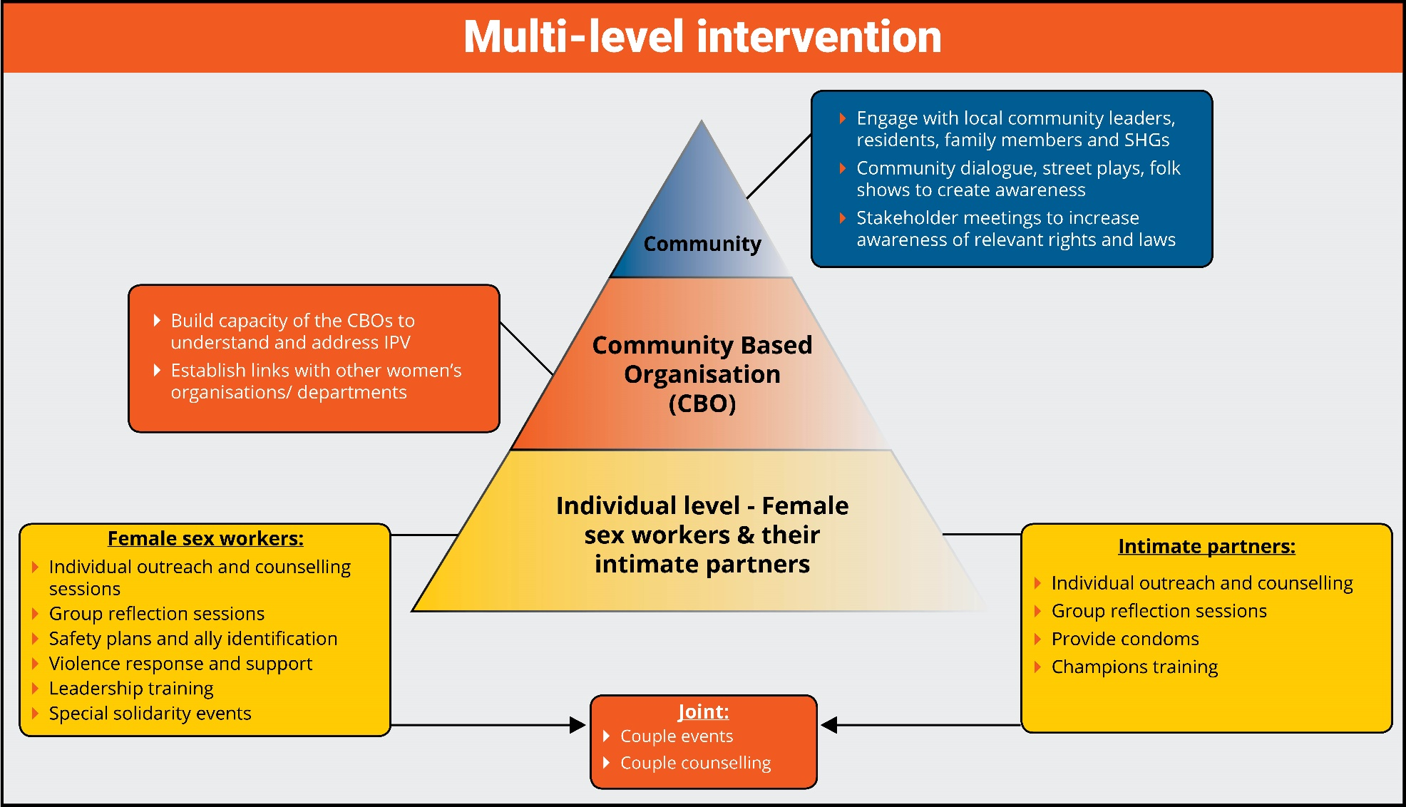
Intervention and Evaluation
A cluster RCT (2015-17) which evaluated the intervention among FSWs at the end of 12 and 24 month of programme implementation

Slide 37
No difference in primary outcomes across arms; lower acceptance of IPV, higher level of self-protection strategies and solidarity among FSWs around IPV issue in intervention
**
**
**
** p<0.05

Slide 38
Low reporting of violence at end line makes the primary outcome results inconclusive

Slide 39
Key learnings
Female sex workers are usually left out from interventions meant to address intimate partner violence against women. VAW programmes need to include women who sell sex to ensure that no one is left behind
This is the first intervention globally which aimed to address IPV against female sex workers and demonstrates the feasibility of delivering such programmes
Intimate partnerships of FSWs are complex, hence a standard approach of programming may not work
Despite these complexities, we found changes in acceptance of IPV, awareness of self-protection strategies and solidarity among FSWs around IPV

Slide 40
Preventing intimate partner violence among women in Tanzania: findings from the MAISHA (CRT01) cluster randomised controlled trial
Saidi Kapiga on behalf of MAISHA trial team

Slide 41
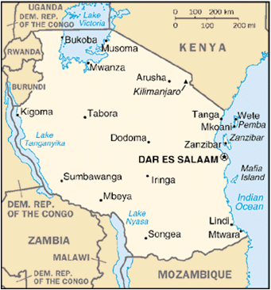
MAISHA Trial
Aim: To evaluate an intervention that aims to empower women, prevent intimate partner violence and promote healthy intimate relationships
Design: Cluster randomised controlled trial
Study population: Women taking part in a group-based microfinance loan scheme
Study site: Mwanza city, north-western Tanzania
Synergy potential: Aim to eliminate all forms of violence and abuse against women and girls (SDG Goal 5, Target 2); reduce risk of HIV (SDG Goal 3, Target 3); and promote mental health and well-being (SDG Goal 3, Target 4)

Slide 42
Baseline findings
Women in Mwanza (n=1,021) experience high rates of intimate partner violence and other forms of abuse
17%
Experienced in the past 12m
Sexual violence
35%
Ever experienced
19%
Physical violence
53%
27%
Physical and/or sexual violence
61%
39%
Emotional abuse
68%
25%
50%
75%

Slide 43
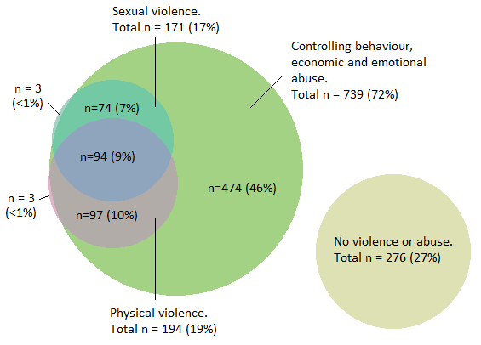
Overlap of different forms of violence and abuse
Only 27% of women did not report experiencing any form of violence or abuse in the past 12 months

Slide 44
Factors associated with violence and abuse
High prevalence of violence and to some extent controlling behaviour was found among:
Young women
Women with less education
Women having a young male partner
Violence and abuse were associated with increased reporting of symptoms of poor mental health

Slide 45
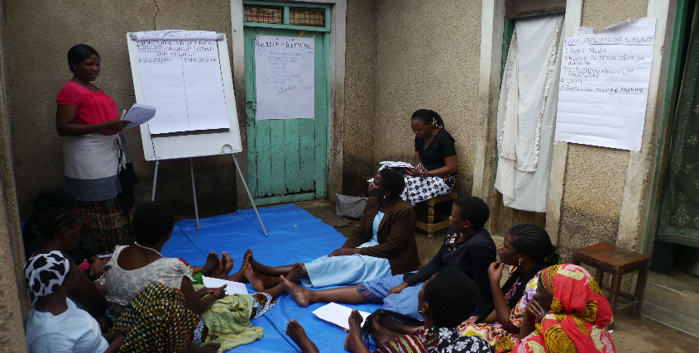
MAISHA intervention
We recruited 66 microfinance groups, 33 (n=544 women) were allocated to intervention and 33 groups (n=505 women) to control
The intervention comprised of 10 sessions given
over 20 weeks
Participatory and reflective, encompassing:
Gender and gender inequalities
Healthy and unhealthy relationships
Effective communication
Power and control in relationships
Conflict resolution
Setting personal boundaries
Sessions were delivered by trained facilitators

Slide 46
Conclusions
The high prevalence of violence and abuses underline the urgent need for developing and testing appropriate interventions to tackle both violence and abusive behaviours among intimate partners
Findings from this important trial will help to determine if the MAISHA intervention will help to reduce violence and abuse in settings like Tanzania
This study shows that it is feasible to implement interventions to address violence and abusive behaviours in existing women’s networks such as microfinance groups

Slide 47
What’s next…?
Presentation of the MAISHA trial results at AIDS 2018:
Confronting violence against women
Thursday 26 July at 14.30
Ongoing work:
What is the impact of the MAISHA intervention on women not receiving microfinance?
What are the similarities and differences between men and women towards violence?
What are the drivers of violence perpetration?
How do we engage men in violence prevention research?

Slide 48
STRIVE: Tackling the structural drivers of HIV
AIDS 2018
Pre-conference meeting 21st July 2018
Co-hosted by STRIVE, DFID, UNAIDS, UNDP, SAT
Notes:
I am Saidi Kapiga and have been a co-research director of STRIVE since its inception. I want to welcome you all to the STRIVE preconference meeting – thank you for joining us today for what I hope is going to be a lively and interactive discussion.

Slide 49
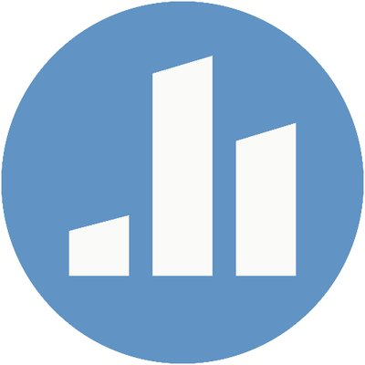
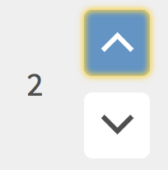
Poll everywhere
During the STRIVE preconference session we will be asking for your help to develop recommendations for the future. Please access the website below and share your thoughts.
If you see another person’s suggestion that you agree with you can also hit the arrow next to it, to raise it in the ranks.
Please start by responding to question 1
Go to pollev.com/strive
Enter a response
Click the up arrow beside responses you agree with

